Slide 1

Microwave based Wireless Charging of cell phones
Presentation by:
Ranjan Yadav
EVD17I009
under the guidance of:
Dr. Prerna Saxena
RF and Microwave Circuit Design
ELE-557T
Department of ECE
Indian Institute of Information Technology
Design and Manufacturing Kancheepuram, Tamil Nadu, 600-127

Slide 2
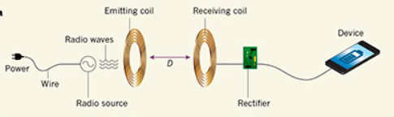
Introduction:
Wireless Power Transfer (WPT) is the transmission of electrical power from a power source to a consuming device without using solid wires or conductors. In simple terms, the electrical power will be transmitted to the target device using electromagnetic waves such as microwaves. The electromagnetic spectrum which is the collection of energies , has been used here for even more broader application. The microwave region is one of the seven regions of electromagnetic (EM spectrum ) is used for this purpose which fall in the range of the EM spectrum between radio waves and infrared waves . Microwaves are the invisible ,super-energetic, short wavelength waves. Microwave technology is used for this purpose because these waves are extensively used for point-to-point telecommunication(i.e non broadcast uses), because their small wavelengths allows conveniently sized antennas to direct them in narrow beams ,which can be pointed directly at the receiving antenna .
Fig-1: Wireless power transfer depiction
Nikola Tesla, in late 1800’s coined and introduced us to the world of wireless transmission which was later researched upon by William.C.Brown who pioneered the technology to transmit power using microwaves giving rise to the term Microwave Power Transmission (MPT). Although introduced in 1964, this technology remains an area of interest for researchers and engineers all over the world, even to this day. Successful implementations of MPT have been done over the world in Japan; MIT where a research team led by Professor Marin Soljacic successfully transmitted power to a 60W light bulb at 40% efficiency over a distance of 2m (7 feet).
Image Sources: Google Images

Slide 3
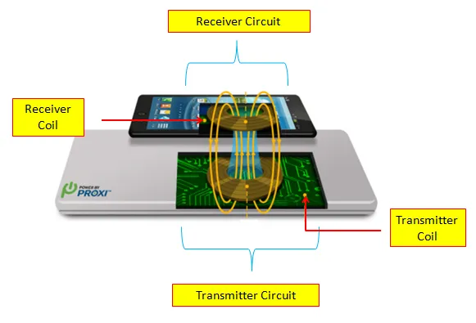
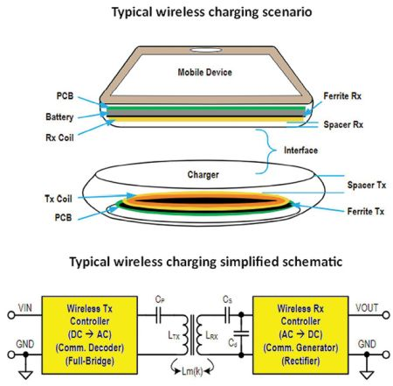
Design:
To accomplish the task of wireless charging there should be a transmitting side which produces microwaves and a receiving side which receives these microwaves and gets charged. Based on this we have we have transmitting and receiving design.
Transmitter Design
The side in the process of wireless mobile charging which acts as the source for microwaves is the transmitting design. At transmitter there is a component called as magnetron . A magnetron is a diode vacuum tube actually behaves as an oscillator to produce microwaves. To help these microwaves to reach to the destination or receiving end , at transmitter side we use waveguide antenna which are kind of funnel which helps to beam out the waves into the air.
Receiver Design
Receiving side process is little difficult as it is more than we think it would be . It receives the signals ,rectifies it and consume them to get the receiving end battery charged . At receiving end we need a sensor which detects the presence of message signals i.e while a subscriber is having conversations. The role playing component at the receiving end is the rectenna which is the term used for both the rectifier and the antenna .
Fig-2: Model diagram
Fig-3: Simplified
schematic
Image Sources: Google Images

Slide 4
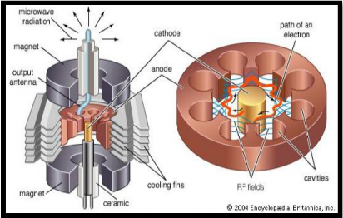
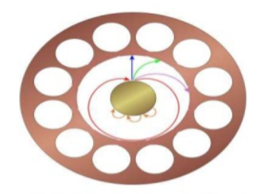
Magnetron:
A magnetron consists of a short copper cylinder with a number of cavities that open into a central vacuum chamber containing a metal cathode. A permanent magnet provides a magnetic field that runs parallel to the axis of the cylinder. The cathode is then heated up by a high voltage direct current, causing it to produce electrons streaming out towards the cylinder wall orthogonally to the magnetic field. The electrons are then deflected by the field into curved paths, causing them to set up circular currents within the cavities. These currents produce microwave radiation at frequencies that are related to the size of the cavities. The microwaves are then directed to towards the mobile device waiting for its reception so as to be converted back to the electrical power through rectenna. Cross field and magnetic field are used to produce high power output.
The slotted waveguide antenna is used to transmit the microwave generated at the transmitter side with the help of magnetron. This antenna has aperture efficiency up to 95 percent making it an almost ideal power transmitter. This particular antenna has a very high power handling capacity with 64 slots.
COMPONENTS OF THE WIRELESS CHARGING SYSTEM:
Fig-4: Magnetron
Fig-5: Path of electron
in magnetron
Image Sources: 2004 Encyclopedia Britannica Inc

Slide 5
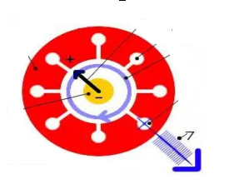
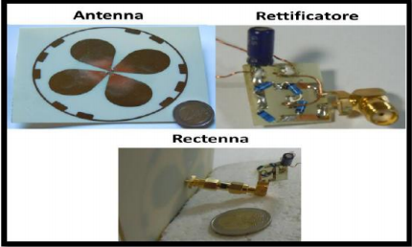
2. Transmitting Antenna:
The transmitting antenna (blue outer arrow) are the structures which convey the microwaves from transmitter to the sky from where receiving antenna catches these signals .
The transmitting antenna is attached to the Tuner which match the impedance of the transmitting antenna and the microwave source. Directional Coupler helps the signal to propagate in a particular direction. It spread the Microwaves in a space and sent it to the receiver side.
3. Rectenna:
Rectenna is a combination of a rectifier and an antenna. At the receiver end, Rectenna which is fitted on the mobile circuitry converts it back to the electrical power and the mobile gets charged.
Rectifying antenna rectifies the received microwave signal energy into the dc current. It comprises of a mesh of dipoles and diodes for rectifying purpose.
A simple rectenna can be constructed by using a schottky diode which is going to be placed in between the antenna dipoles. The diode rectifies the current induced in the antenna by the microwave energy.
Fig-6: Antenna
Fig-7: Rectenna design
Image Sources: Google Images

Slide 6
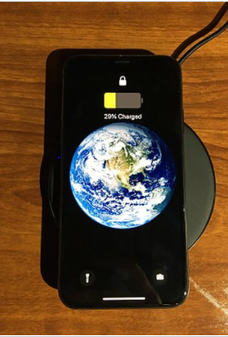
4. Sensory Circuit:
Sensor circuit is a sensor employed at receiver side which is required for the detection of message signals while on call because microwaves are available during that time and mobile phone has to get charged as long as the sensor detects the message signals.
The sensor outputs the presence of message signals to the rectenna i.e. the sensor works in front of rectenna as an indicator of the presence of microwaves. It would simply act as a triggering switch for the rectenna. Thus on receiving the message signal the sensor circuit will trigger the rectenna to be switched ON and vice versa.
Fig-8: Iphone getting wirelessly charged
Image Sources: Wikipedia/Inductive-Charging

Slide 7
Advantages:
Less cords: This one’s a no brainer. With wireless technology, you don’t need to carry around your USB-c charger wherever you go. You just need one cable that is connected to the charging mat.
Universal compatibility: Qi charging is the universal standard, so if you have multiple different wireless capable devices, you can use the same charging pad without any issue.
Safer connections: Since the charging is all occurring inside an enclosed environment and without cords, there’s no corrosion because there is no exposure to water or oxygen. This also means that there is less risk of electrical faults.
More durable: Without having to regularly plug or unplug, there’s also no wear and tear on the smartphone sockets. If you alternate between charging wirelessly and with cables, this also means less wear and tear on your cables.
No overheating of battery: When your smartphone is fully charged, the wireless charger automatically shuts off. This means less energy, a safer charge, and no overheated battery.

Slide 8
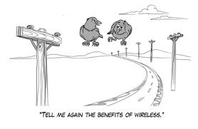
Drawbacks:
This system needs a device rectenna which should be of molecular size otherwise the mobile devices would become bulky .
The charging efficiency decreases with the increased distance between two sides .
The charging devices have been found heating up quickly than the direct contact electricity.
Also, the microwaves are very harmful and can cause serious problem in humans like cataract.
The work for improving the efficiency is going on.
Image Sources: Google Images

Slide 9
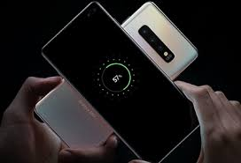
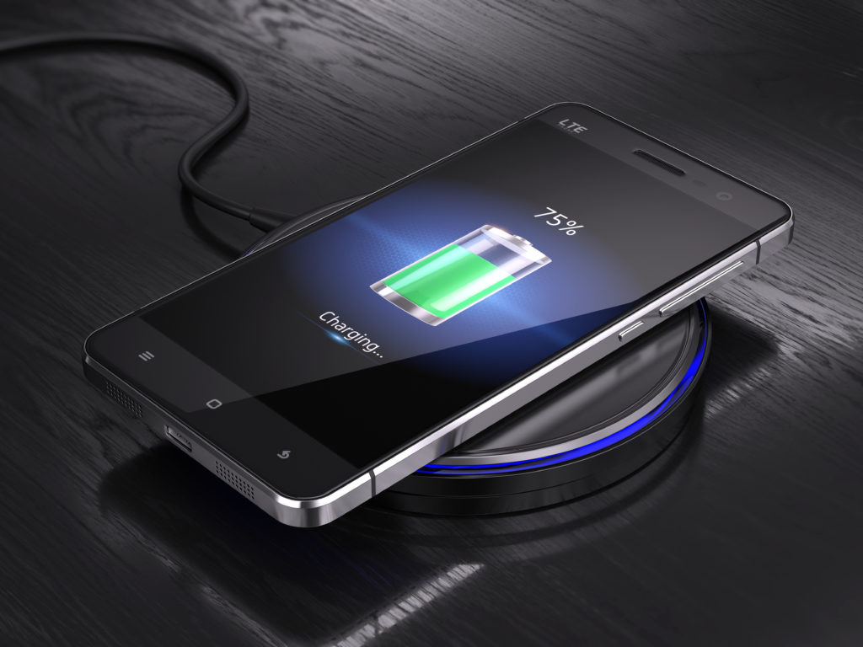
CONCLUSION AND FUTURE SCOPE:
The novel method of charging the mobile phones with the use of microwave power without using wired chargers is definitely the hot topic when it comes to implementation. As, it is a wireless technique this technology can be implemented even in remote areas devoid of charging facilities.
The limitations of wirelessly cell phones charging can be overcome with time and more research like to increase the the distance of power transmission, its biological and global effects thus making its future prospects bright for researchers all around the world.
A new milestone in the revolution of mobile phone technology will be achieved by novel use of RECTENNA AND SENSOR. As Dr Neville of NASA stated “You don’t need cables, pipes or copper wires to receive power. We can send it to you like a cell phone call- where you want it, when you want it, in real time.” We hope for a future like that.
Image Sources: Google Images

Slide 10
References:
Wireless Charging Of Mobile Phones Using Microwaves by Sheikh Shahnawa , Ab Waheed , Shahid Mohiuddin Bhat.
WIRELESS CHARGING USING MICROWAVES by Srinath Nair and Loukik Pingle.
https://www.rokform.com/blogs/rokform-blog/the-pros-and-cons-of-wireless-charging
https://en.wikipedia.org/wiki/Inductive_charging
Thank You
For your support

